Slide 1


Early Career Investigator Data Blitz

Slide 2

[NAME] [poster title]
Replace with a picture of you!
Portrait layout
Cropped to 5:4 dimensions.
Poster #XX
Replace with your name
No titles (Dr/Mr etc)
I’ll add your poster number here – I don’t expect you to find it ☺
You can use the title slide on the next page to add your information so you don’t have to individually delete all the helpful boxes!
Replace with your poster title
Do not add additional information (logos etc) to this slide. Use your two data slides for that information.
#ABC2019 #DataBlitz

Slide 3
[NAME] [poster title]
Poster #XX
#ABC2019 #DataBlitz

Slide 4
Replace this slide with whatever you’d like.
Remember that you only have 2 minutes and you’re advertising your awesome research not trying to explain the whole project. (Hopefully lots of people will come to your poster to find out the details.)
The audience is quite diverse but very interested in your work. Make sure to focus on the big picture and explain what’s interesting about your study, be as engaging as you can, and have fun!
You may use standard power point animations and there are no constraints on fonts, background colour or content…except:
Do not change the background via the master slide as your slides will be incorporated into a complete slide deck and will therefore need to have this same white template for all slides.
For the same reason please do not change the size and aspect ratio of the slides (16:9).
You only get 2 slides. No more. Any additional slides will not be incorporated into the master deck.
If you embed videos or link to images you run the risk of them not rendering properly (this happened at the last data blitz – well done Nick for improvising at the last minute). If you want to risk it please give Kirstie as much time as possible (eg – before Monday morning) to check that the embedding works.
Kirstie will compile these slides on a windows machine and they will be shown on a windows laptop at the conference. If you have any doubts on whether your slides are compatible, please make sure to test them on a windows version of PPTX before you send them along.

Slide 5
Replace this slide with whatever you’d like.
Remember that you only have 2 minutes and you’re advertising your awesome research not trying to explain the whole project. (Hopefully lots of people will come to your poster to find out the details.)
The audience is quite diverse but very interested in your work. Make sure to focus on the big picture and explain what’s interesting about your study, be as engaging as you can, and have fun!
You may use standard power point animations and there are no constraints on fonts, background colour or content…except:
Do not change the background via the master slide as your slides will be incorporated into a complete slide deck and will therefore need to have this same white template for all slides.
For the same reason please do not change the size and aspect ratio of the slides (16:9).
You only get 2 slides. No more. Any additional slides will not be incorporated into the master deck.
If you embed videos or link to images you run the risk of them not rendering properly (this happened at the last data blitz – well done Nick for improvising at the last minute). If you want to risk it please give Kirstie as much time as possible (eg – before Monday morning) to check that the embedding works.
Kirstie will compile these slides on a windows machine and they will be shown on a windows laptop at the conference. If you have any doubts on whether your slides are compatible, please make sure to test them on a windows version of PPTX before you send them along.

Slide 6
Fill in the answers to this slide and send it back with your data blitz slides
One of the goals of the data blitz is to share your research far and wide. We’re scheduled before lunch on the first day and so you have a great chance to bring conference delegates to your poster right after the talk, but there will also be a large audience following along online.
Kirstie will schedule live tweets to accompany your data blitz presentations. The information on this slide lets her know the information she needs to make that communication as effective as possible.
Please answer the following questions in line (edit the bold text):
Would you like to include screenshots of your slides in the tweet to accompany the title slide? Y / N
Who should be tagged in the tweet? @you @lab-name @collaborator etc (answer “none” for no-one)
Would you like to write a custom tweet? (if yes, please add below)
Do you consent to having your slides included in the publicly archived version on https://figshare.com? Y / N
The point of publicly archiving the slides is so that they can be see and cited beyond the people who are online at the time. You can see an example talk at https://doi.org/10.6084/m9.figshare.5886475. (We haven’t done this for a datablitz before so this is a talk by Kirstie from a couple of years ago.)
You can also upload your poster to figshare and add the link to your slides if you’d like to disseminate the research further: https://knowledge.figshare.com/articles/item/how-can-figshare-help-my-research

Slide 7
Some example slides from the previous Cambridge Neuroscience Data Blitzes
For your reference. You can delete the following slides when you send yours to Kirstie

Slide 8
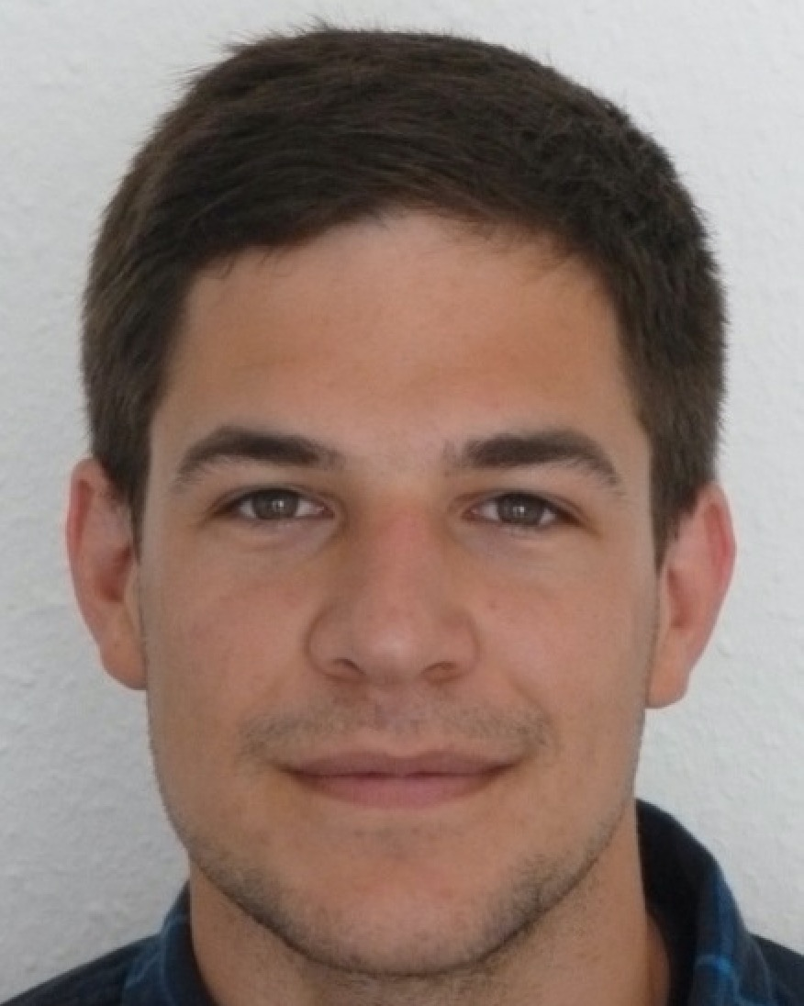
František Váša Adolescent development of structural brain networks
Poster #72

Slide 9

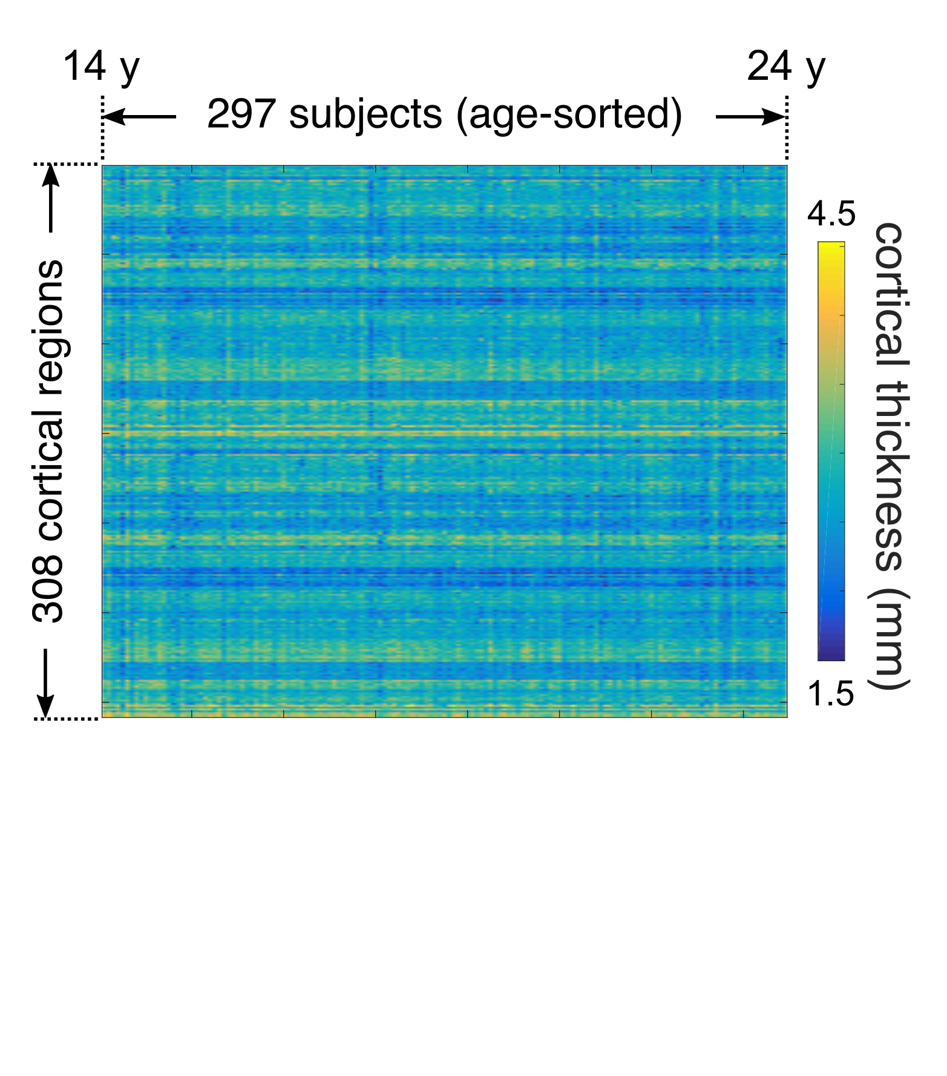
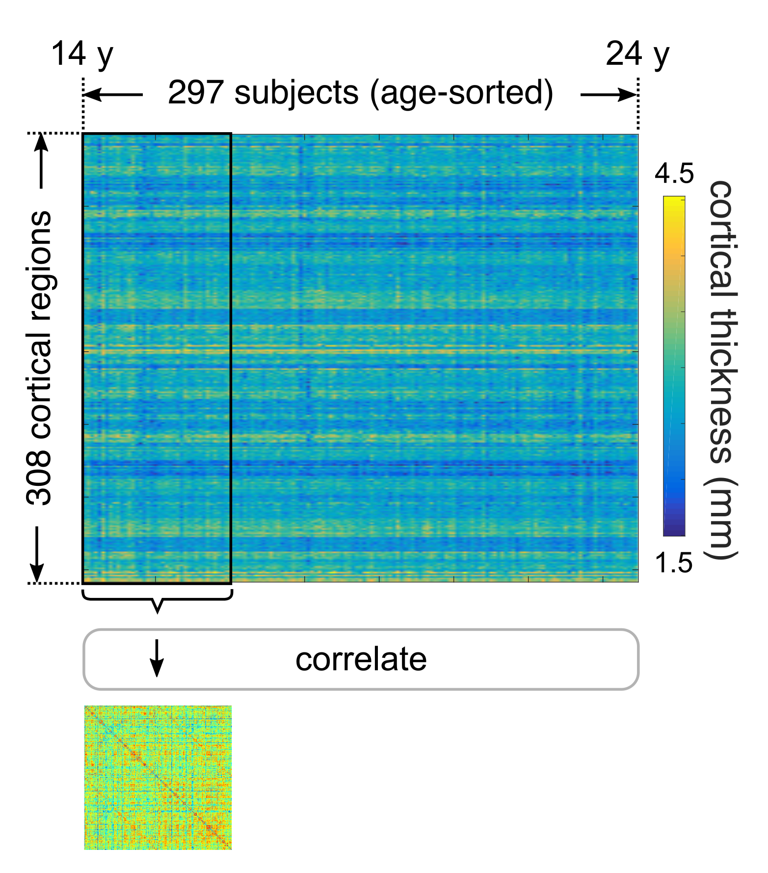
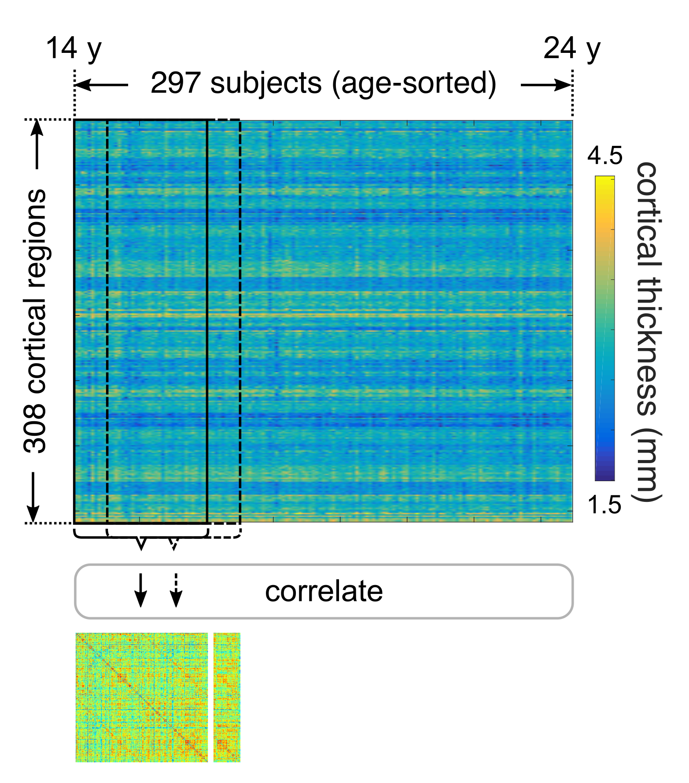

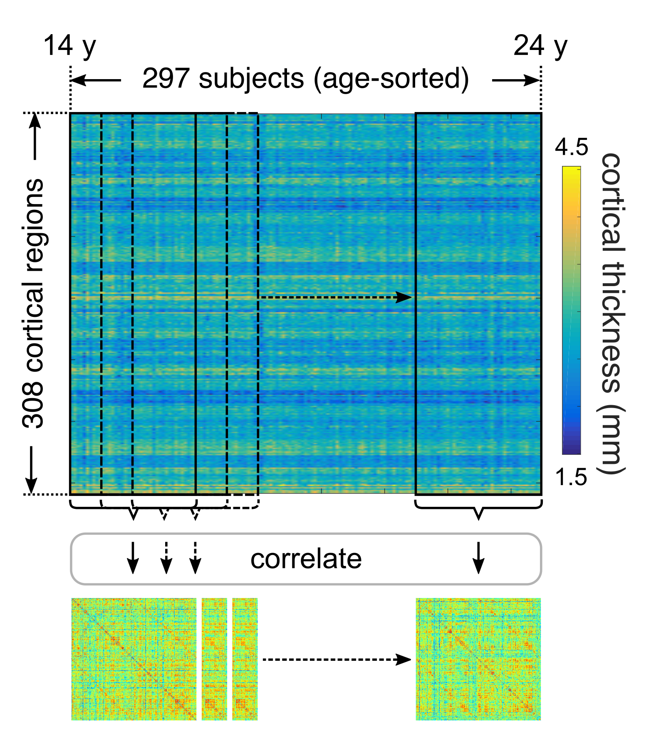
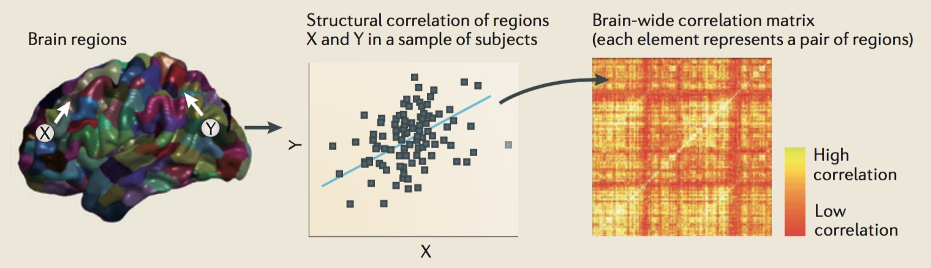
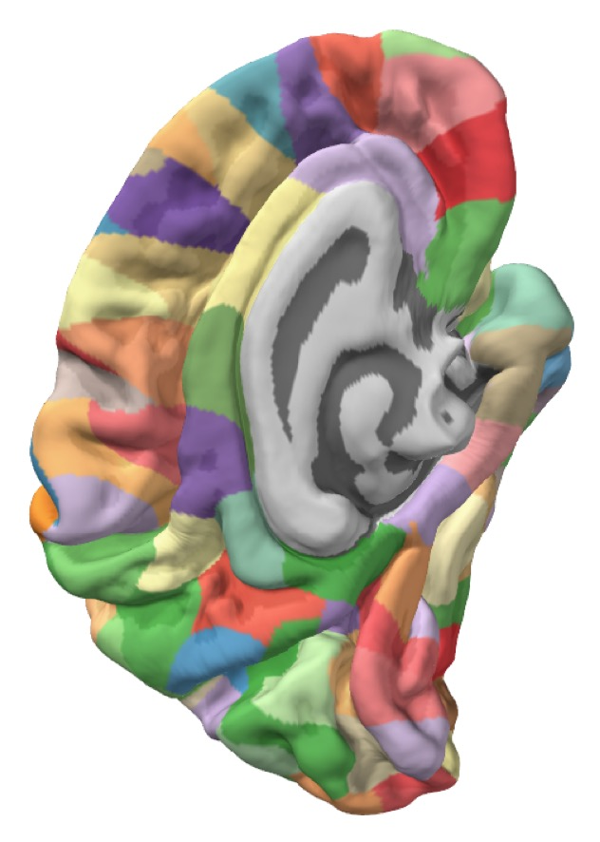
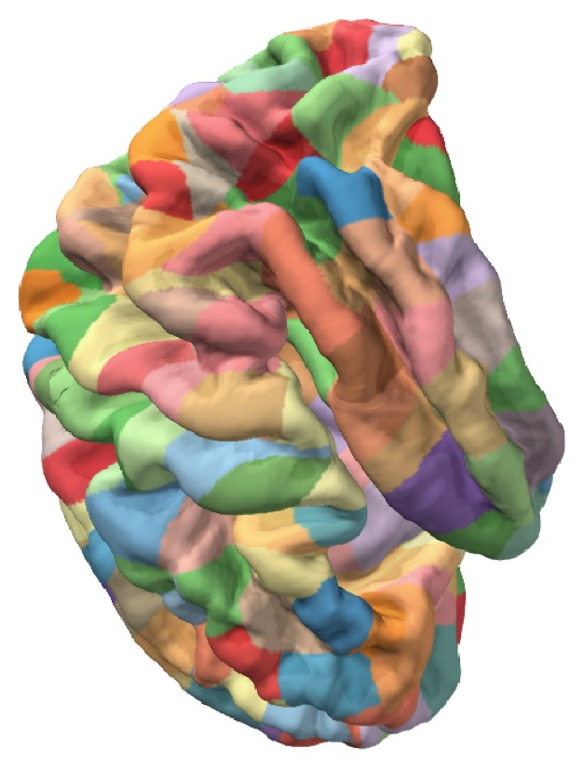
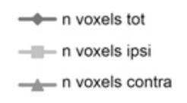
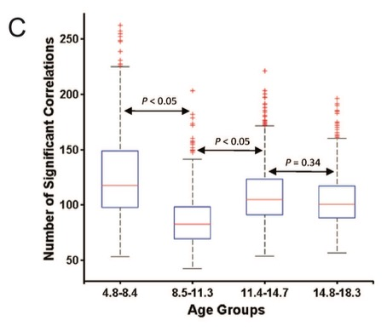
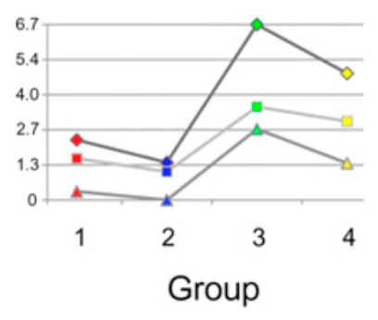
Adolescent development of structural brain networks
František Váša | University of Cambridge, Dept. of Psychiatry | #72
Alexander-Bloch et al. Nat. Rev. Neurosci. 2013
Zielinski et al. PNAS 2010
Khundrakpam et al. Cereb. Cortex 2013

Slide 10
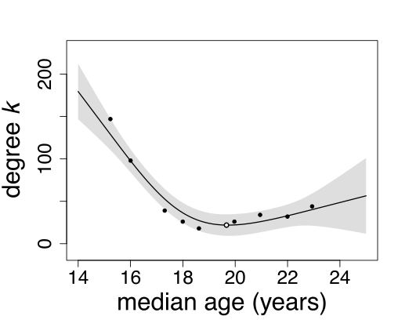
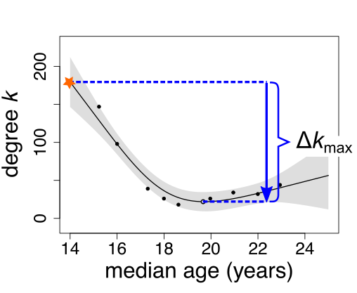
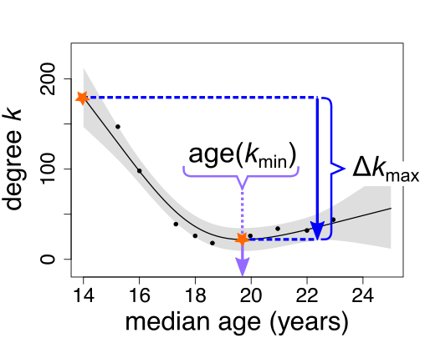
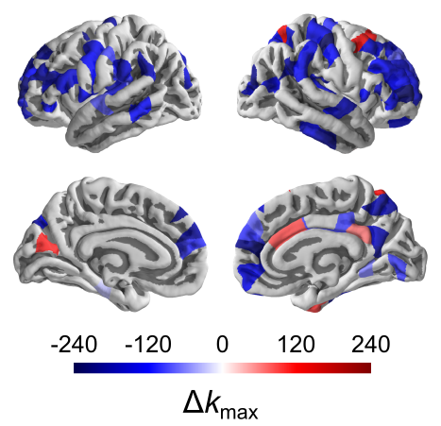
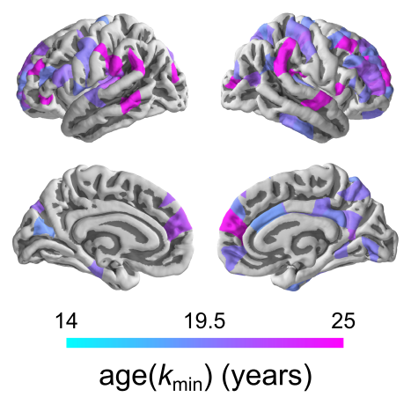
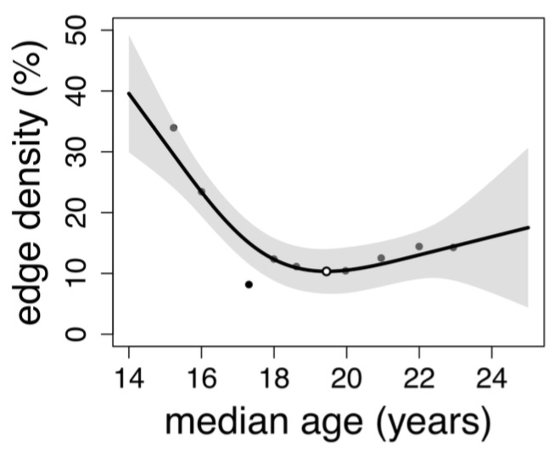



+
E. Bullmore
O. Sporns
J. Seidlitz
K. Whitaker
R. Romero-Garcia
G. Rosenthal
A. Alexander-Bloch
P. Vértes
M. Shinn
I. Goodyer
Adolescent development of structural brain networks
P. Jones
R. Dolan
P. Fonagy
František Váša | University of Cambridge, Dept. of Psychiatry | #72
+ the NSPN Consortium
Global development
Local development
r²_{adj} = 0.81, p = 0.0069
example region: left DLPFC
Paper (and code, and data) available:
Generously supported by:
(in press)

Slide 11

James Hockley Molecular Profiling Of Colonic Sensory Neurons By In Vivo Retrograde Labelling And Single-Cell RNA Sequencing
Poster #14

Slide 12
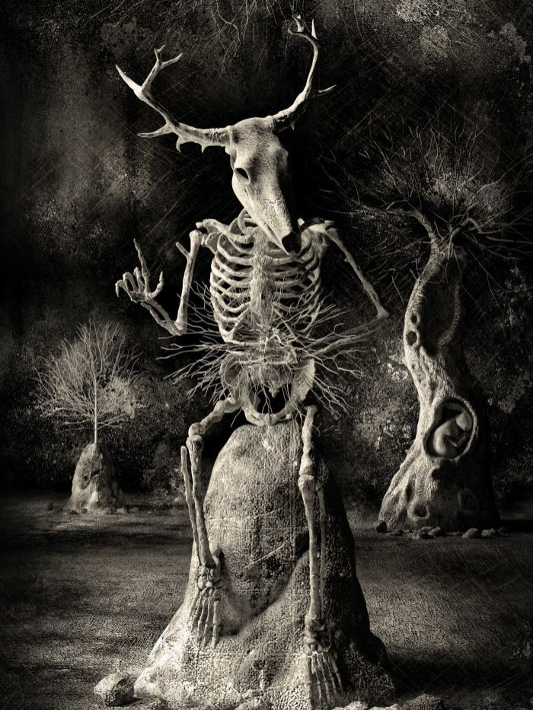
Poster #14
Molecular Profiling Of Colonic Sensory Neurons
By In Vivo Retrograde Labelling And
Single-Cell RNA Sequencing
James Hockley
Department of Pharmacology
Stickman - The Vicissitudes of Crohn's
Spooky Pooka

Slide 13
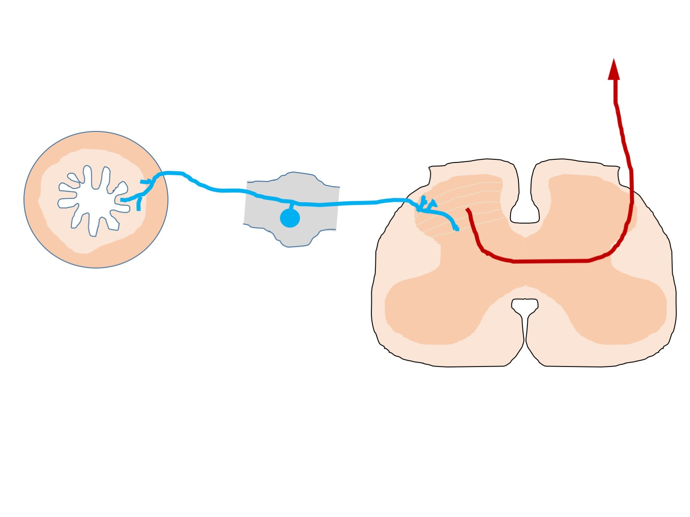
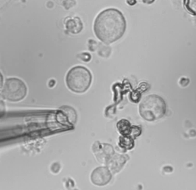
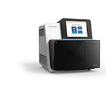
Poster #14
Molecular Profiling Of Colonic Sensory Neurons
By In Vivo Retrograde Labelling And
Single-Cell RNA Sequencing
James Hockley
Department of Pharmacology
To the brain
Dorsal root
ganglia
Colon
Distension
Inflammation
Spinal Cord
Molecular fingerprint of individual colonic sensory neurones

Slide 14
Thank you!

